Slide 1
Genetic Algorithms (GAs)
Iwan Njoto Sandjaja

Slide 2
Introduction
Many optimization problems are very complex in nature and quite hard to solve by conventional techniques
Since 1960 → Imitating living beings to solve such kinds of hard optimatization problems
Simulating the natural evolutionary process of human beings result in stochastic optimization techniques called evolutionary algorithms → genetic algorithms (GAs), evolutionary programming (EP), and evolutionary strategies (ESs)

Slide 3
The well-known application of GAs
Scheduling and sequencing
Reliability design
Vehicle routing and scheduling
Group technology
Facility layout and location
Transportation
and many others

Slide 4
General Structure of GAs
Genetic algorithms are stochastic search techniques based on the mechanism of natural selection and natural genetics
GAs start with an initial set of random solution called population
Each individual in the population is called chromosome, representing a solution to the problem at hand
The chromosomes evolve through succesive iteration, called generations

Slide 5
General Structure of GAs
During each generation, the chromosomes are evaluated, using some measure of fitness
To created a new chromosome called offspring, are formed by either :
  Merging two chromosome from current generation using a crossover operator
  Modifying a chromosome using a mutation operator

Slide 6
General Structure of GAs
A new generation is formed by :
  Selecting, according to the fitness values some parent and offspring
  Rejecting others so as to keep the population size constant
Fitter chromosomes have higher probabilities of being selected
After several generations, the algorithms converge to the best chromosome, which hopefully represents the optimum or suboptimal solution to the problem

Slide 7
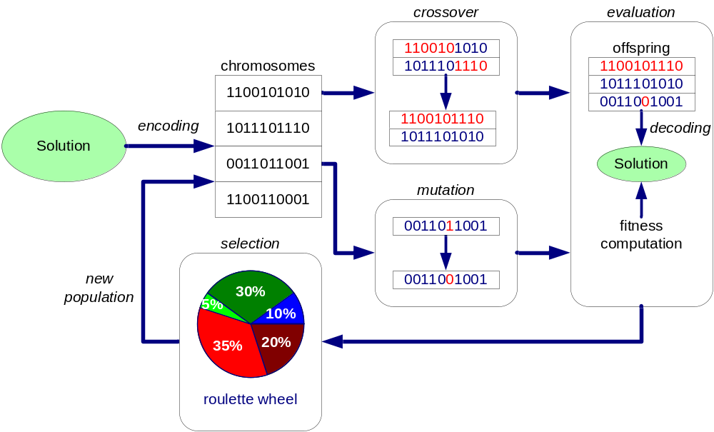
General Structure of GAs
Genetic operation
Evolution operation

Slide 8
General Structure of GAs
The genetic operations mimic the process of heredity of genes create new offspring at each generation
The evolution operation mimics the process of Darwinian evolution to create populations from generation to generation
Remember, the theory of evolution is wrong

Slide 9
Procedure: Genetic Algorithms
Let P(t) and C(t) be parents and offspring in current generation t
  begin
  t ← 0;
  initialize P(t)
  evaluate P(t)
  while (not termination condition) do
  recombine P(t) to yield C(t);
  evaluate P(t);
  select P(t+1) from P(t) and C(t);
  t ← t + 1;
  end
  end

Slide 10
Flowchart of GAs
Init.
Population
Evaluation
Selection
Crossover
Start
Generate
new population
Mutation
NO
Stop?
Evaluation
YES
End

Slide 11
Crossover
Crossover is the main genetic operator
The crossover rate (denoted p_{c}) is defined as the ratio of the number of offspring produced in each generation to the population size (usually denoted pop_size)
This ratio controls the expected number p_{c}x pop_size of choromosome to undergo the crossover operation

Slide 12
Crossover
A higher crossover rate allows exploration of more of the solution space and reduces the chances of settling for false optimum
But if this rate too high, it results in the wastage of a lot of computation time in exploring uncompromising region of the solution space

Slide 13
Crossover for Binary Encoding
Single Point Crossover
  one crossover point is selected, binary string from the beginning of the chromosome to the crossover point is copied from the first parent, the rest is copied from the other parent
Two Point Crossover
  two crossover points are selected, binary string from the beginning of the chromosome to the first crossover point is copied from the first parent, the part from the first to the second crossover point is copied from the other parent and the rest is copied from the first parent again
Uniform Crossover
  bits are randomly copied from the first or from the second parent
Arithmetic Crossover
  some arithmetic operation is performed to make a new offspring

Slide 14
Mutation
Mutation is background operation which produces spontaneous random changes in various chromosomes, serves the crucial role of either :
  Replacing genes lost from population during the selection process
  Providing the genes that were not present in the initial population
The mutation rate (denoted by p_{m}) is defined as the percentage of the total number of genes in population

Slide 15
Mutation
The mutation rate control the rate at which new genes are introduced into the population for trial
If it is too low, many genes that would have been useful are never tried
If it is too high, there will be much random pertubation, the offspring will start losing their resemblance to the parents and algorithm will lose the ability to learn from the history search

Slide 16
GAs vs Conventional Optimization and Search procedures
GAs work with coding of solution set, not the solutions themselves
Genetic algorithms search from a population solutions, not a single solution
Genetic algorithms use payoff information (fitness function) not derivatives or other auxiliary knowledge
Genetic algorithms use probabilistic transition rules, not deterministic rules

Slide 17
Exploitation and Exploration
Search can be perform with either blind strategies or heuristic strategies
Blind search strategies do not use information about the proble domain

Slide 18
Population-Based Search

Slide 19
Major Advantages
GAs do not have much mathematical requirement about optimization problem
The ergodicity of evolution operator makes genetic algorithms very effective at performing global search (in probability
GAs provide us a great flexibility to hybridize with domain-dependent heuristics to make an efficient implementation for specific problem

Slide 20
Genetic Algorithm Vocabulary

Slide 21
Examples with Simple GAs
Optimization Problem
max f(x₁,x₂) = 21.5 + x1 sin (4πx₁) + sin(20πx₂)
-3.0 ≤ x₁ ≤ 12.1
4.1 ≤ x₂ ≤ 5.8

Slide 22
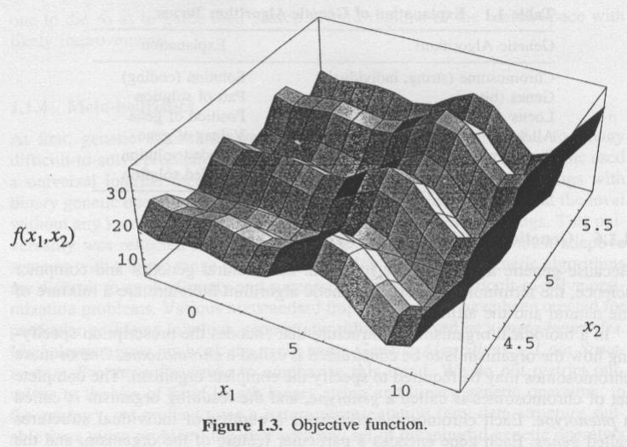
Three Dimensional Plot

Slide 23
Function Object in Matlab
[x,y] = meshgrid( 4:.1:6, -3:0.8:13);
Z = 21.5 + x * sin(4*pi*x) + y * sin(20*pi*y);
mesh(x,y,Z,'EdgeColor','black')

Slide 24
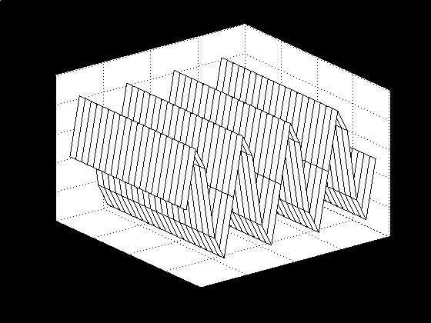
Matlab 3D Plot

Slide 25
Representation
Encode decision variables into binary strings
The length of the string depends on the required precision
For example the domain of variable x_{j} is [a_{j},b_{j}] and the required precision is five places after the decimal point
The precision requirement implies that the range of domain of each variable should be divided into at least (b_{j} - a_{j}) x 10⁵ size ranges

Slide 26
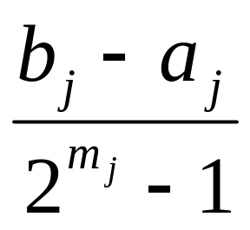
Representation
The required bits (denoted with mj) for variable is calculated as follows:
2^{mj-1}< (b_{j} - a_{j}) x 10⁵ ≤ 2^{mj}-1
The mapping from binary string to a real number for variable xj is straight-forward and completed as follows:
x_{j} = a_{j} + decimal(subtring_{j}) x

Slide 27
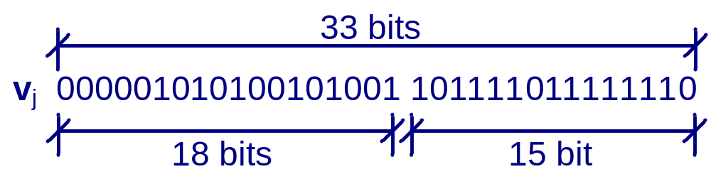
Representation
(12.1-(-3.0)) x 10,000 = 151,000
2¹⁷< 151,000 ≤ 2¹⁸ m₁ = 18
(5.8-(-4.1)) x 10,000 = 17,000
2¹⁴< 17,000 ≤ 2¹⁵ m₂ = 15
m = m₁ + m₂ = 18 + 15 = 33
The total length of a chromosome is 33 bits

Slide 28
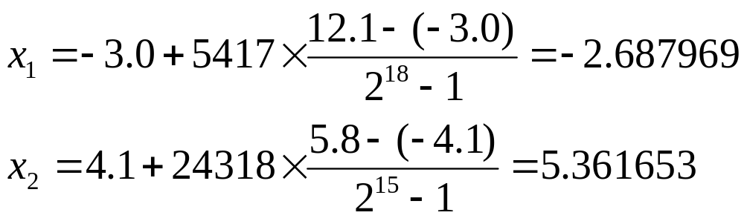
Representation
 | Binary Number | Decimal Number
x₁ x₂ | 000001010100101001 101111011111110 | 5417 24318

Slide 29
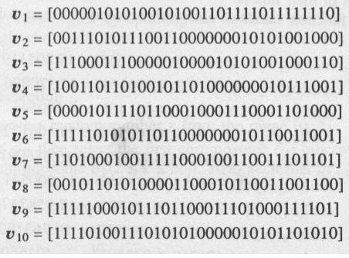
Initial Population
v₁ = [ 000001010100101001101111011111110]
v₂ = [ 000001010100101001101111011111110]
v₃ = [ 000001010100101001101111011111110]
v₄ = [ 000001010100101001101111011111110]
v₅ = [ 000001010100101001101111011111110]
v₆ = [ 000001010100101001101111011111110]
v₇ = [ 000001010100101001101111011111110]
v₈ = [ 000001010100101001101111011111110]
v₉ = [ 000001010100101001101111011111110]
v₁₀ = [ 000001010100101001101111011111110]

Slide 30
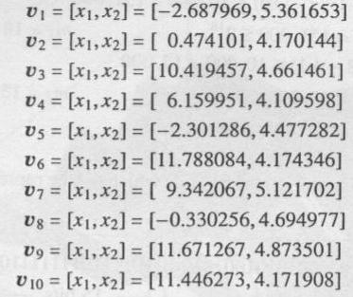
Initial Population
v₁ = [x₁,x₂] = [-2.687969 ,5.361653 ]
v₂ = [x₁,x₂] = [-2.687969 ,5.361653 ]
v₃ = [x₁,x₂] = [-2.687969 ,5.361653 ]
v₄ = [x₁,x₂] = [-2.687969 ,5.361653 ]
v₅ = [x₁,x₂] = [-2.687969 ,5.361653 ]
v₆ = [x₁,x₂] = [-2.687969 ,5.361653 ]
v₇ = [x₁,x₂] = [-2.687969 ,5.361653 ]
v₈ = [x₁,x₂] = [-2.687969 ,5.361653 ]
v₉ = [x₁,x₂] = [-2.687969 ,5.361653 ]
v₁₀ = [x₁,x₂] = [-2.687969 ,5.361653 ]

Slide 31
Evaluation
Convert the chromosome’s genotype to its phenotype
  Here this means converting binary string into relative real values x^{k} = (x₁^{k},x₂^{k}), k = 1,2,..,pop_size
Evaluate the objective function
Convert the value of objective function into fitness
  For maximization problem, the fitness is simply equal to the value of objective function eval
  (v^{k})=f(x^{k}), k = 1,2,..,pop_size

Slide 32
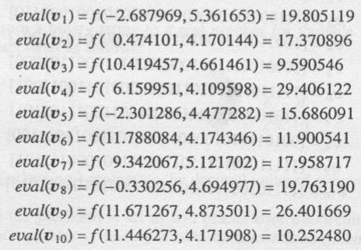
Evaluation
v₄ is the strongest one and v₃ is the weakest one

Slide 33
Selection
In most practice a roulette wheel approach is adapted as selection procedure
It belongs to fitness-propotional selection and can select a new population with respect to probability distribution based on fitness values

Slide 34
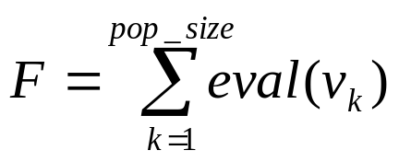
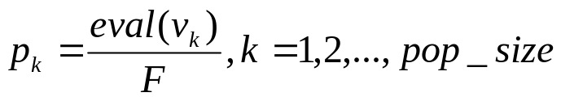
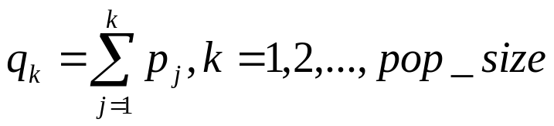
Roulette Wheel
Calculate the fitness value eval(v_{k}) for each chromosome v_{k}:
eval(v_{k}) = f(x), k = 1,2,…,pop_size
Calculate the total fitness for the population:
Calculate selection probability p_{k} for each chromosome v_{k}:
Calculate cumulative probability q_{k} for each chromosome v_{k}:

Slide 35
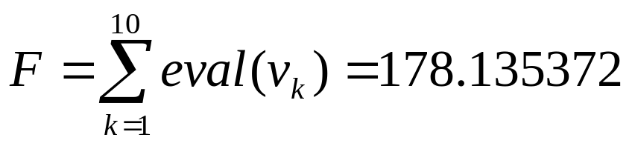
Procedure: Selection
Step 1. Generate a random number r from the range [0,1]
Step 2. If r ≤ q₁, then select first chromosome v₁; otherwise, select the kth chromosome v_{k}
(2 ≤ k ≤ pop_size) such that q_{k-1} < r ≤ q_{k}
The total fitness F of the population is

Slide 36
Procedure: Selection
The probability of a selection p_{k} for each chromosome v_{k}(k = 1,…,10) is as follows:
p₁ = 0.111180 | p₂ = 0.097515 | p₃ = 0.053839
p₄ = 0.165077 | p₅ = 0.088057 | p₆ = 0.066806
p₇ = 0.100815 | p₈ = 0.110945 | p₉ = 0.148211
p₁₀ = 0.057554

Slide 37
Procedure: Selection
The cumulative probalities q_{k} for each chromosome v_{k}(k = 1,…,10) is as follow:
q₁ = 0.111180 | q₂ = 0.208695 | q₃ = 0.262534
q₄ = 0.427611 | q₅ = 0.515668 | q₆ = 0.582475
q₇ = 0.683290 | q₈ = 0.794234 | q₉ = 0.942446
q₁₀ = 1.000000

Slide 38
Procedure: Selection
Spin the roullete wheel for 10 times
Let us assume that random sequence of 10 numbers from range [0,1] is as follows:
0.301431 | 0.322062 | 0.766503 | 0.881893
0.350871 | 0.583392 | 0.177618 | 0.343242
0.032685 | 0.197577

Slide 39
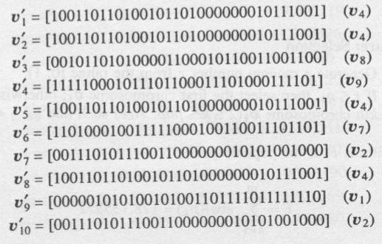
Procedure: Selection
Finally, the new population consists of the following chromosomes:

Slide 40
Crossover
Crossover used here is one-cut-point method, which:
  randomly selects one cut-point and
  exchanges the right part of two parents to generate offspring
Consider two chromosomes as follows, and the cut point is randomly selected after 17th gene:

Slide 41
Procedure: Crossover
The probability of crossover is set as pc = 0.25, so we expect that, on average, 25% of chromosomes undergo cross over
  begin
  k ← 0;
  while (k ≤ 10) do
  r_{k} ← random number from [0,1];
  if (r_{k} < 0.25) then
  select v_{k} as one parent for crossover;
  end
  k ← k + 1;
  end
  end

Slide 42
Procedure: Crossover
Assume that the sequence of random numbers is
This means that the chromosomes v’₅ and v’₇ were selected for crossover
0.625721 | 0.266823 | 0.288644 | 0.295114
0.163274 | 0.567461 | 0.085940 | 0.392865
0.770714 | 0.548656

Slide 43
Procedure: Crossover
Generate a random integer number from the range [1,32] (because 33 is the total length of a chromosome) as cutting point, or in other words, the position of the crossover point
Assume the generated number pos equals 1

Slide 44
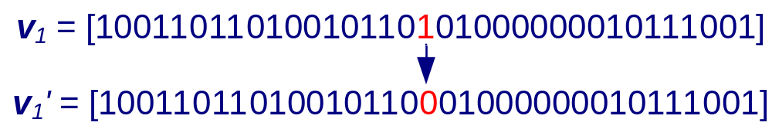
Mutation
Mutation alter one or more genes with probability equal to the mutation rate
Assume 18th gene of the chromosome v₁ is selected for a mutation

Slide 45
Mutation
The probability of mutation is set as
p_{m} = 0.01, so we expect that, on average, 1% of total bit of population would undergo mutation
There are m x pop_size = 33 x 10 = 330 bits in whole population
We expect 3.3 mutation per generation
Every bit has an equal chance to be mutated

Slide 46
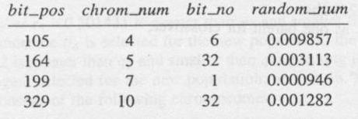
Mutation
Thus, we need to generate a sequence of random number r^{k} (k = 1,...,330) from the range [0,1]

Slide 47
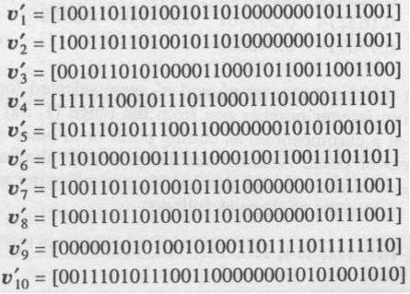
Mutation
After mutation, we get the final population as follows

Slide 48
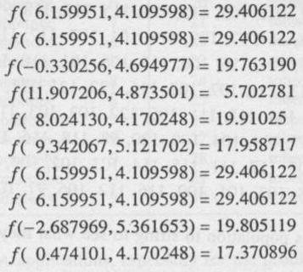
Mutation
The corresponding decimal values of variables [x1,x2] and fitness are as follow:

Slide 49
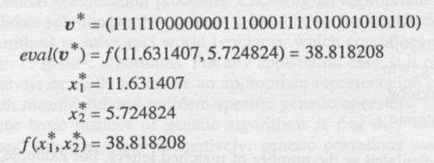
Finished….???
Now we just completed one iteration of genetic algorithm.
The test is terminated after 1000 generations
We have the best chromosome in 419th generation as follows:

Slide 50
Word-Matching Problem
This example was given by Freeman
The word-matching problem tries to evolve an expression of “to be or not to be” from randomly-generated lists of letters with genetic algorithm
Since there are 26 possible letters for each of 13 locations in the list, the probability that we the correct pharse in a pure random way is
(1/26)¹³ = 4.03038 x 10⁻¹⁹
We use a list of ASCII integers [97,122] to encode the string letters

Slide 51
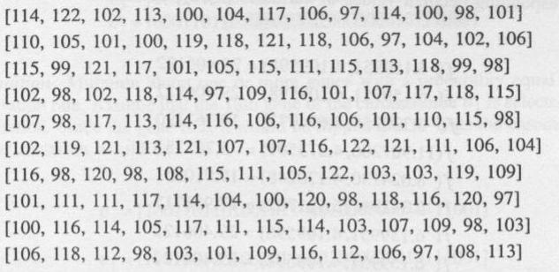
Initial Population

Slide 52
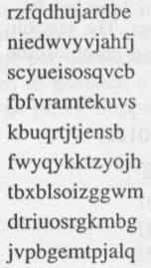
Convert to String
Fitness is calculated as the number of matched letters

Slide 53
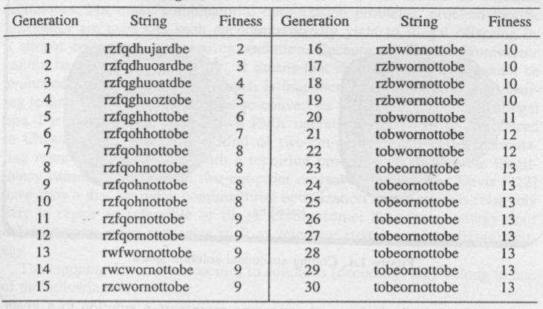
The Best String Result for Each Generation

Slide 54
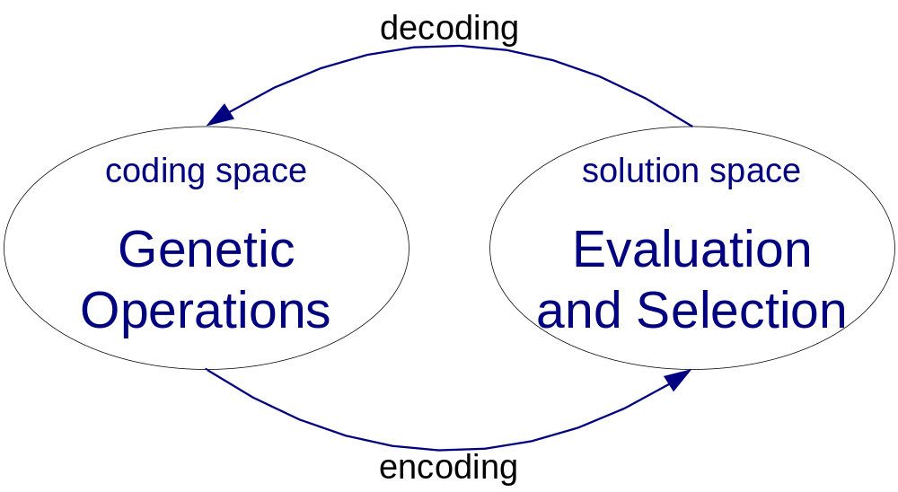
Encoding Problem

Slide 55
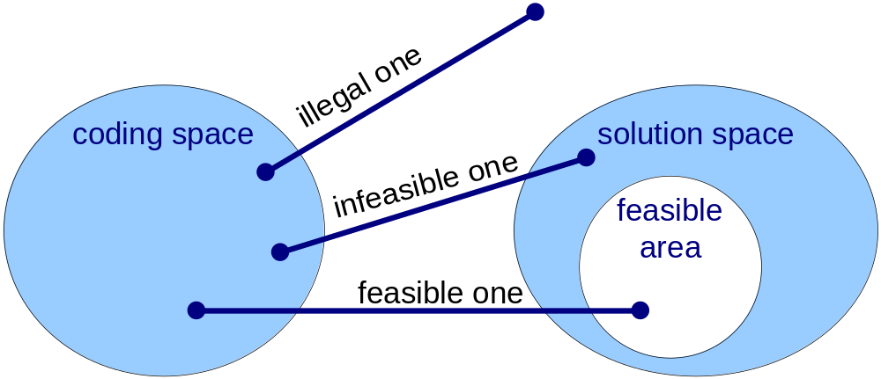
Encoding Problem

Slide 56
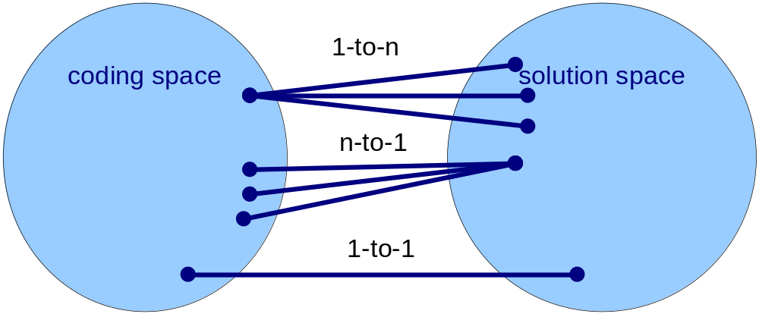
Mapping

Slide 57
Selection
Sampling Space
Sampling Mechanism
Selection Probability

Slide 58
Sampling Space
Regular Sampling Space
Enlarged Sampling Space

Slide 59
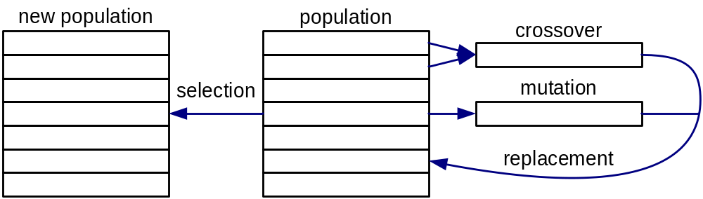
Regular Sampling Space

Slide 60
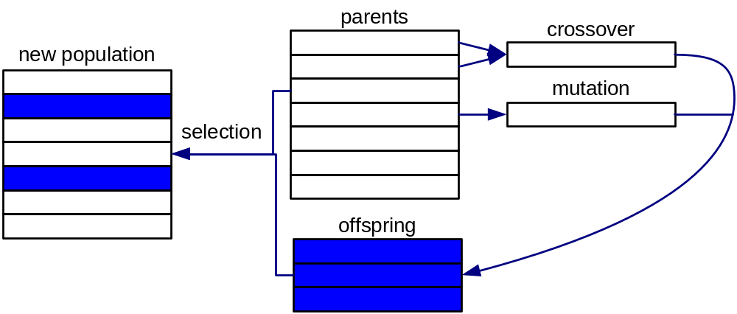
Enlarged Sampling Space

Slide 61
Major Advantages
GAs do not have much mathematical requirement about optimization problem
The ergodicity of evolution operator makes genetic algorithms very effective at performing global search (in probability
GAs provide us a great flexibility to hybridize with domain-dependent heuristics to make an efficient implementation for specific problem

Slide 62
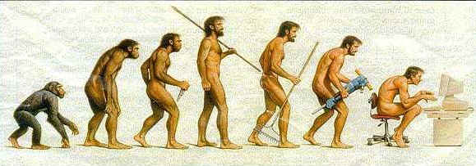
The End
Evolution or Devolution?

Slide 63
Links
http://cs.felk.cvut.cz/~xobitko/ga/
http://www.aic.nrl.navy.mil/galist/
http://www-illigal.ge.uiuc.edu/index.php3
http://www.rennard.org/alife/english/gavintrgb.html
http://lancet.mit.edu/ga/

Slide 65
Sampling Mechanism

Slide 68
Selection Probability

Slide 71
Selective Pressures

Slide 74
Hybrid Genetic Algorithms

Slide 77
The End
Evolution or Devolution?

